Slide 1
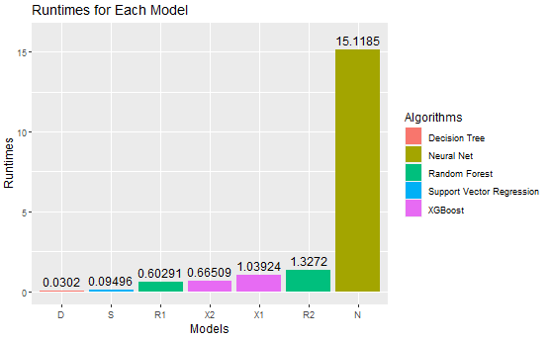
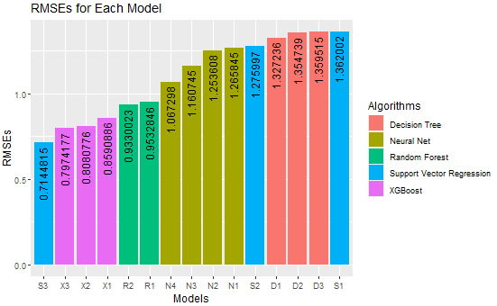
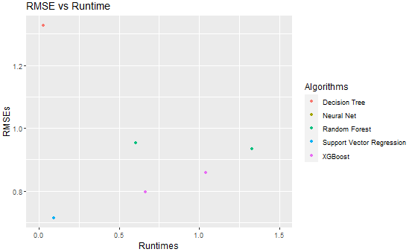

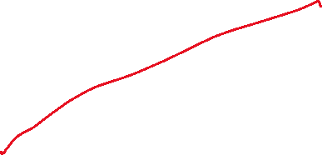

Slide 2
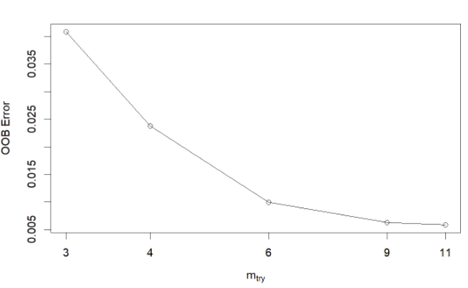
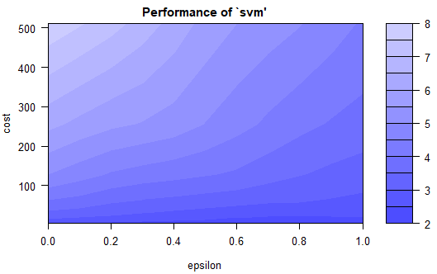
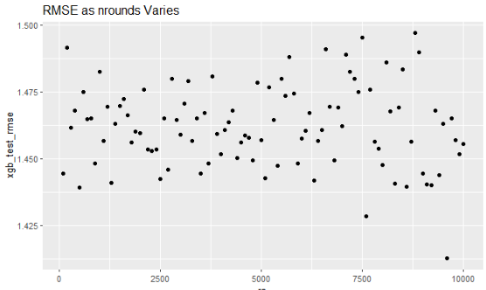
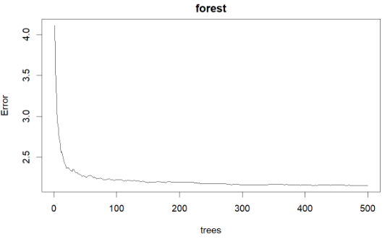
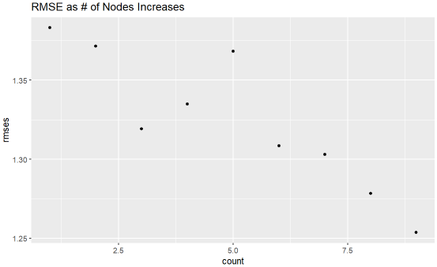


Tuning
RMSE | cost | gamma | epsilon
1.027639 | 1 | 1 | 0.1
0.959714 | 1 | 2 | 0.1
0.938717 | 1 | 3 | 0.1
0.929753 | 1 | 4 | 0.1
0.925406 | 1 | 5 | 0.1
0.922958 | 1 | 6 | 0.1
0.921523 | 1 | 7 | 0.1
0.920643 | 1 | 8 | 0.1
0.920093 | 1 | 9 | 0.1
0.919741 | 1 | 10 | 0.1
0.919528 | 1 | 11 | 0.1
0.919396 | 1 | 12 | 0.1
0.919315 | 1 | 13 | 0.1
0.919269 | 1 | 14 | 0.1
0.919246 | 1 | 15 | 0.1
0.919234 | 1 | 16 | 0.1
0.901837 | 2 | 1 | 0.1
0.804706 | 2 | 2 | 0.1
0.776533 | 2 | 3 | 0.1
0.765852 | 2 | 4 | 0.1
0.761130 | 2 | 5 | 0.1
0.758839 | 2 | 6 | 0.1
0.757697 | 2 | 7 | 0.1
0.757084 | 2 | 8 | 0.1
0.756758 | 2 | 9 | 0.1
0.756596 | 2 | 10 | 0.1
0.756534 | 2 | 11 | 0.1
0.756530 | 2 | 12 | 0.1
0.755971 | 3 | 2 | 0.1
0.732803 | 3 | 3 | 0.1
0.725413 | 3 | 4 | 0.1
0.722720 | 3 | 5 | 0.1
0.721815 | 3 | 6 | 0.1
0.721532 | 3 | 7 | 0.1
0.721499 | 3 | 8 | 0.1
0.721017 | 4 | 3 | 0.1
0.716482 | 4 | 4 | 0.1
0.715219 | 4 | 5 | 0.1
0.714981 | 4 | 6 | 0.1
0.714883 | 5 | 4 | 0.1
0.714482 | 5 | 5 | 0.1
Decision Tree
cp w/ manual: 1.327236 → 1.354739
~0.47 secs for 2 trees
Random Forest
ntreeTry w/ graph (on the right)
mTry w/ tuneRF(): 0.9532846 → 0.9330023
~4.40 secs for 4 forests
XGBoost
max_depth & eta w/ hypergrid: 0.8590886 → 0.8080776
~3.17 mins for 324 models
nrounds w/ separate hypergrid: 0.8080776 → 0.8080776
gamma & alpha w/ manual: 0.8080776 → 0.7974177
Neural Network (x10 method)
1 layer w/ custom loop: 1.253608
2 layers w/ custom loop: 1.160745
~5.50 mins for 81 networks
3 layers w/ custom loop: 1.067298
~13.02 mins for 729 networks
Support Vector Regression (list tracking method)
cost & epsilon w/ tune(): 1.362002 → 1.275997
~ 50.21 secs for 80 reps
More specific tuning made it worse
cost & epsilon & gamma w/ custom loop: 1.275997 → 0.7144815
~9.13 mins for 6250 reps

